Slide 1
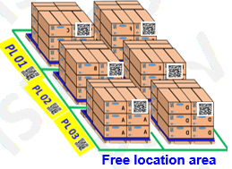
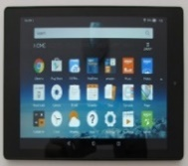

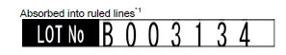
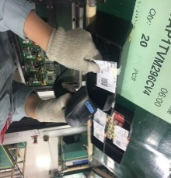
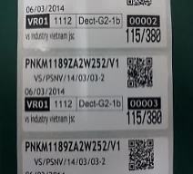

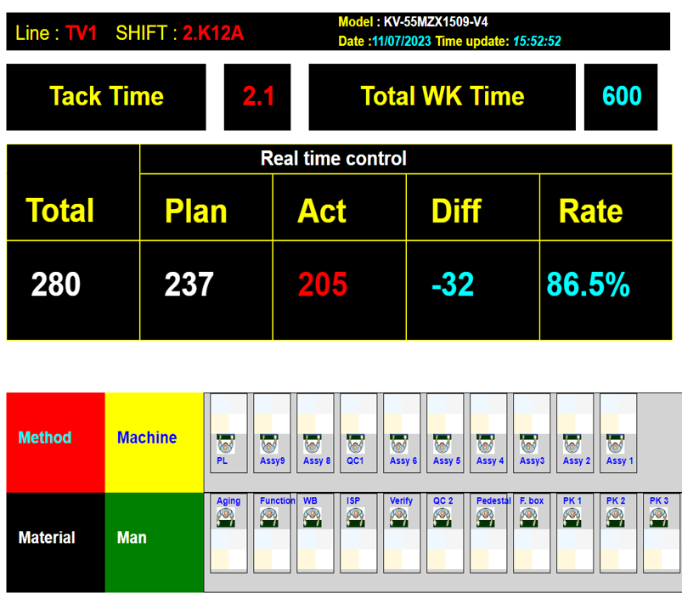
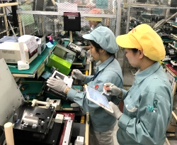
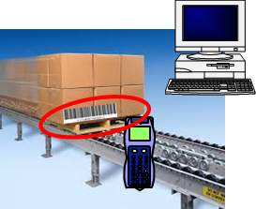
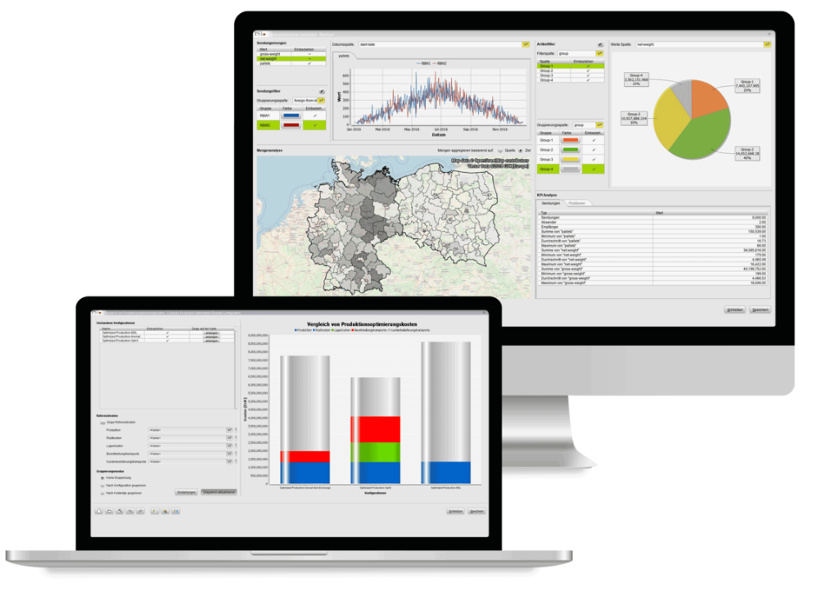

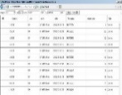

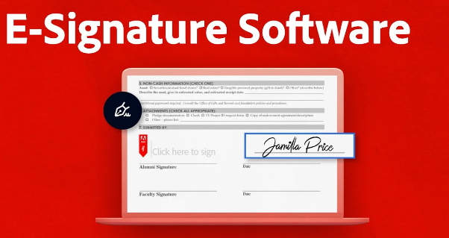

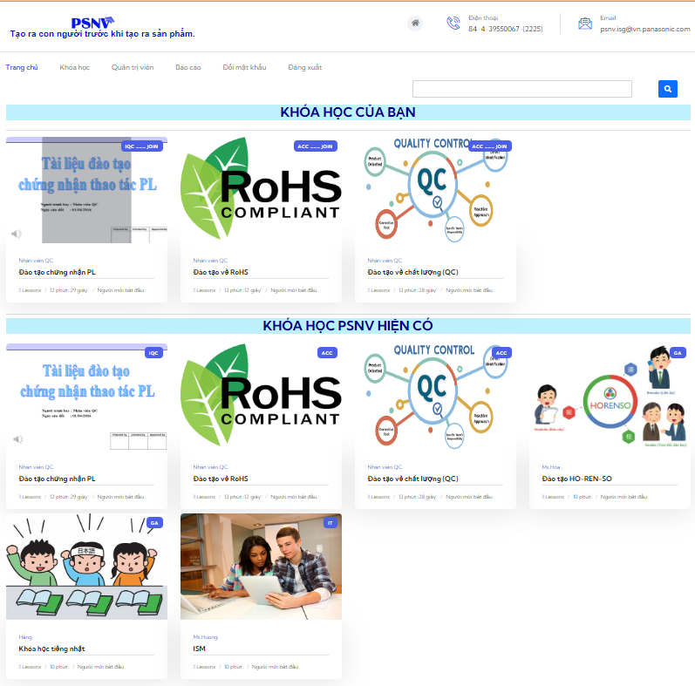
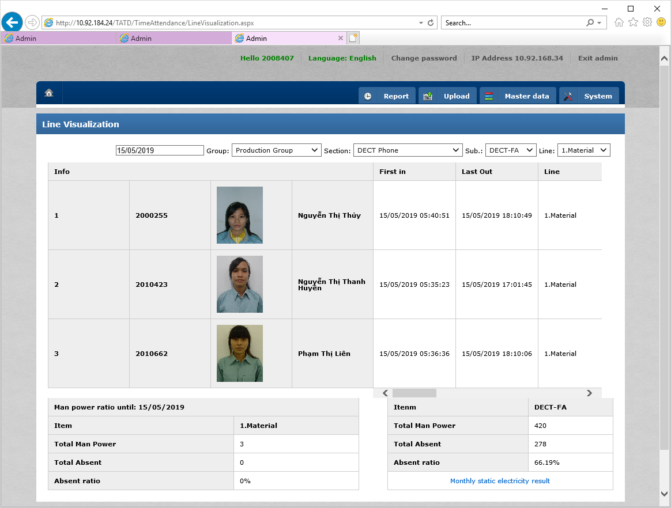

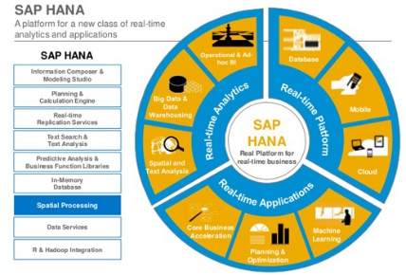


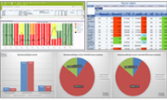
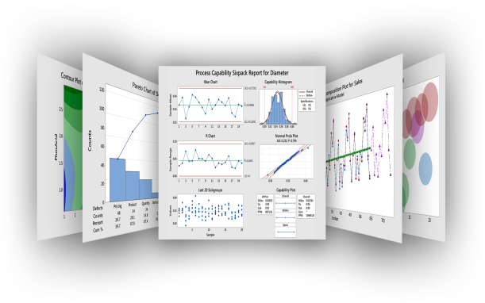


2. Direction of Smart Factory
1
■Data usage level
Level 3
Data collection/
accumulation
Level 4
Analysis and prediction
using data
Level 5
Control and optimization
using data
1
STRENGTHEN FACTORY STREAMLINE TIGHTEN CONTROL
2022
MCS
PQC
SMT
DIP
PMD
FA
QC
PSCD
Full-fill all process
by System
SAP
Sys
ECN change
Part A -> B
Part No :
A
DB
Part card:
A
DB
DB
SAP
QTY:
30
Date
Plant
Cat
Please check carefully
Free loc. & Smart W/H control
Insp./urgent Part,
in order & Map.
Check Part by character scan
Verify part card in DIP Process
Injection, printing process control
Cell Management.
Multi Job by Tablet
Shipping Control
Traceability
System
2024
Standardization
Linkage systems
2
REDUCE OFFICE MANUAL JOB BY E-OFFICE (E-Learning, E-Leave, E-OT, E-Work, E-EVALUATION, E-SIGN, E-Assistant)
E-Learning, E-Leave , E-OT, E-Work
MBO
KPI
Performance
Effort
E-EVALUATION
(Approval)
E-Assistant
E-Office
2026
IP
Management
Optimization
DB
Chatbot
3
TOWARDS SMART FACTORY
2028
Toward
Smart Factory
Signal & Data
Analysis
KPIs
Dashboard
Visualization
Predict system
with AI
2030
Notes:
業務・工程で多くのデータの収集・蓄積はできている状況ですが、
まだ紙による業務が存在するのも事実です。
次の段階であるデータによる分析・予測にチャレンジしていくためにも、レベル３のブラッシュアップとして
さらなるペーパーレス化にも取り組んで参ります。

Slide 2
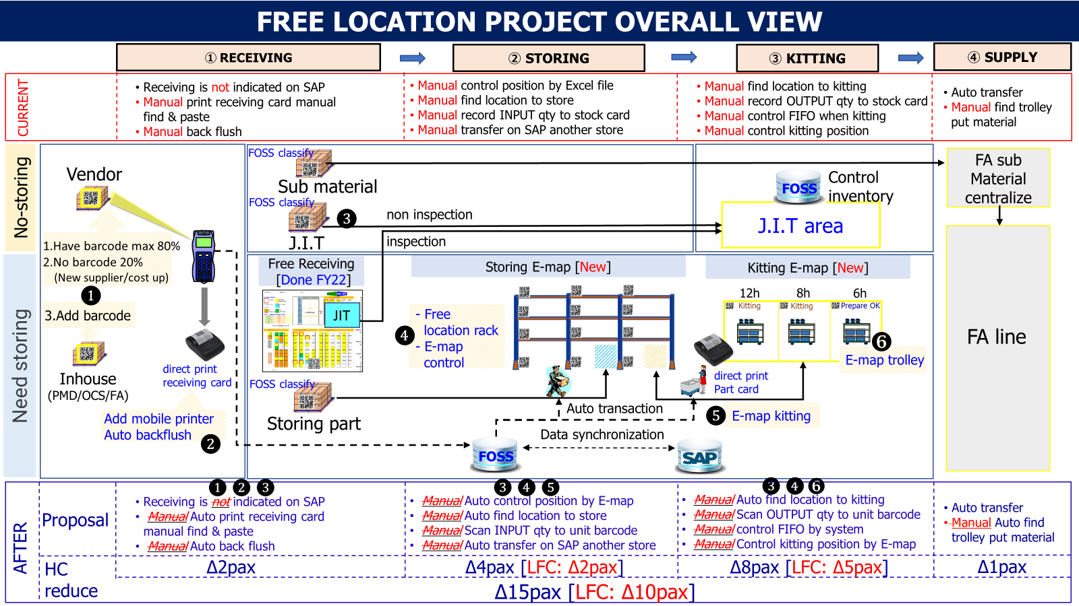
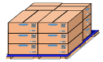



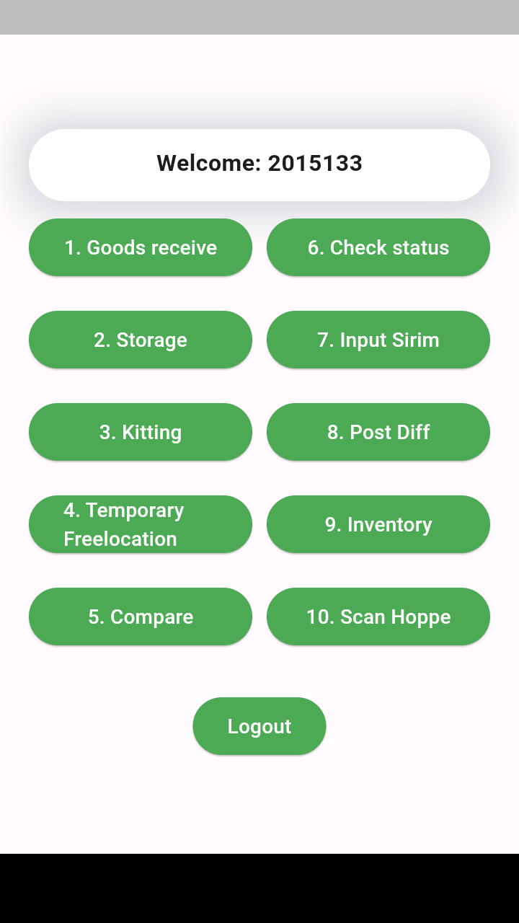
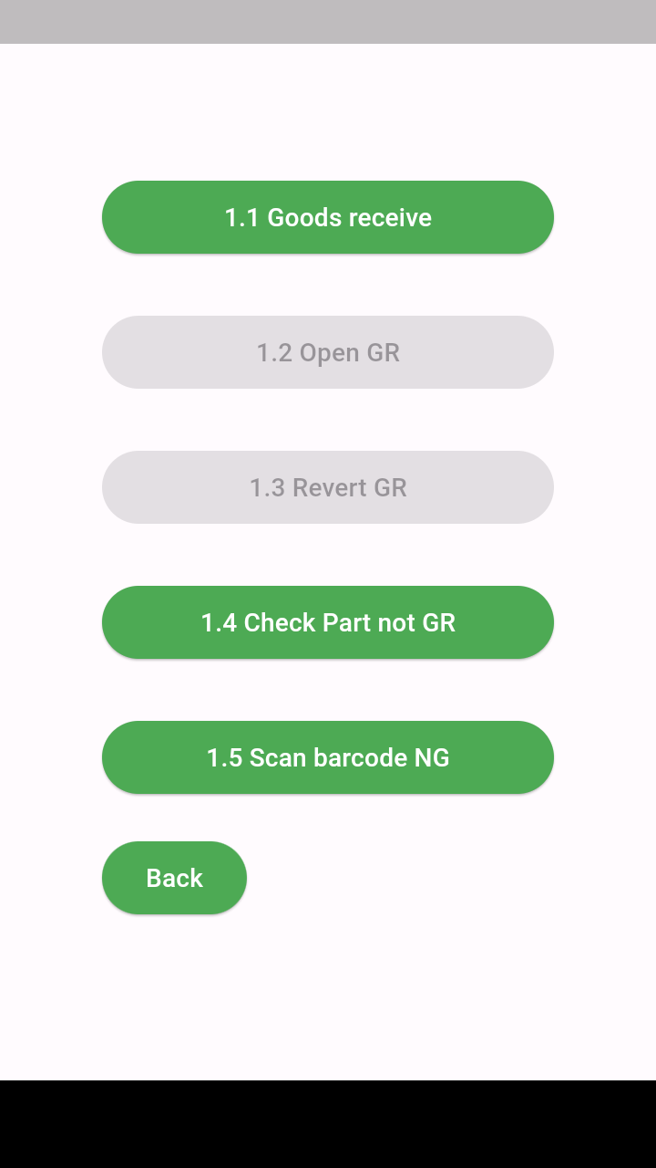
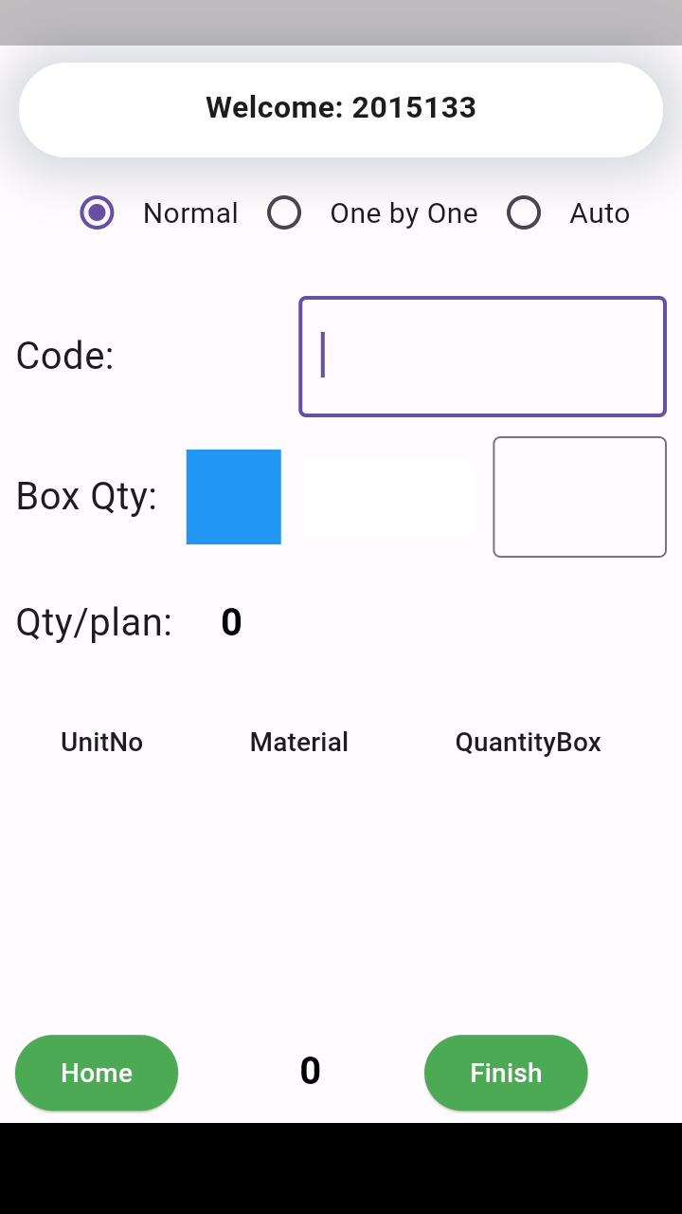
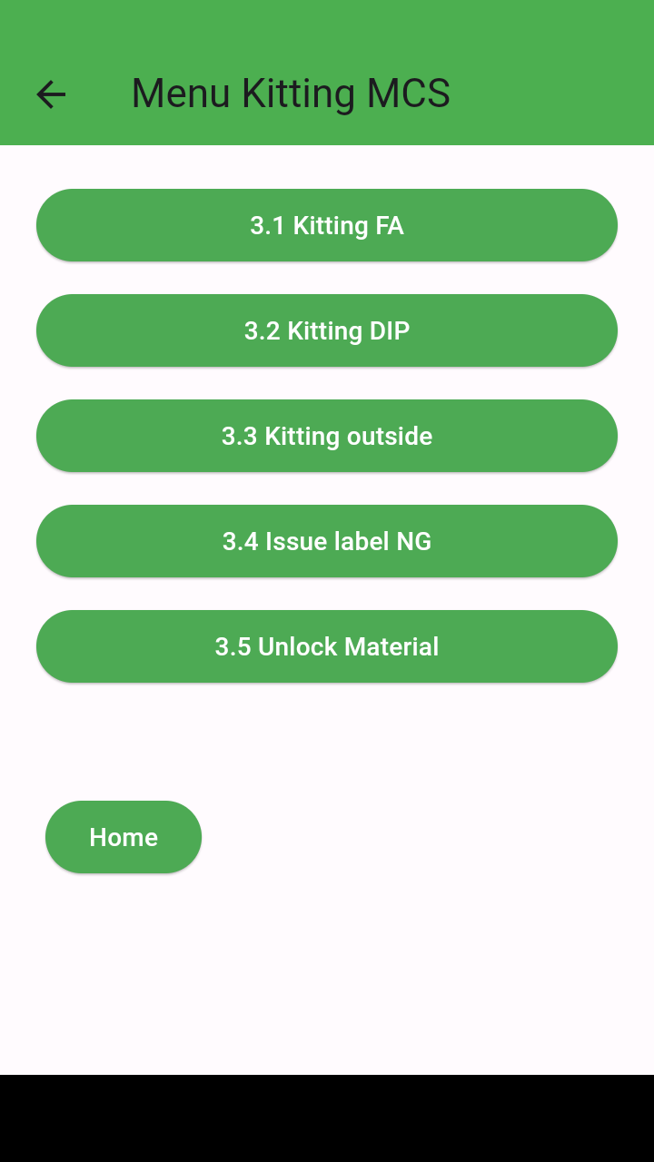
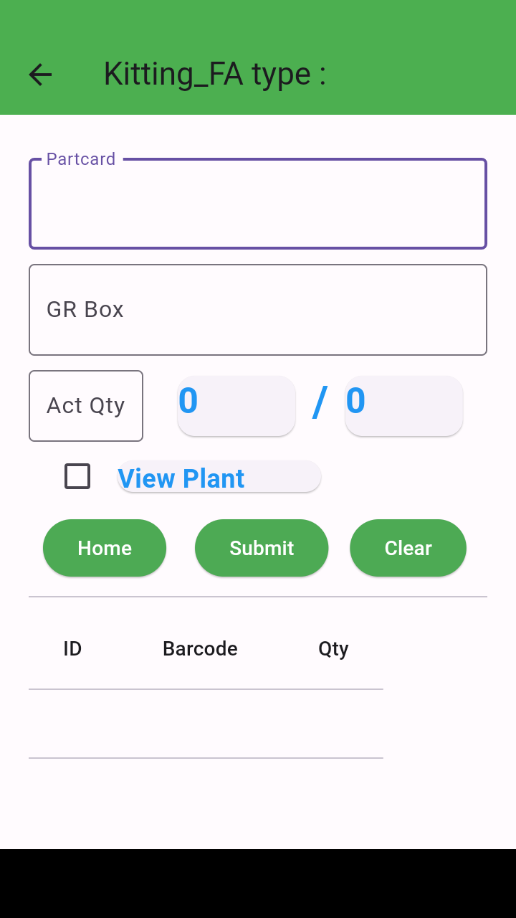
3-2. Smart warehouse management system
2
・Involve ISD members to improve QCD.
・Reap results from the second half with a vertical launch through sufficient testing
* Improved data accuracy between FOSS and SAP
Data synchronization
FOSS
* Screen under development
[Overall Project Progress Timeline]
MILESTONE 1
Goods Receiving
and temp location
MILESTONE 2
Storing
MILESTONE 3
Kitting, Supply
MILESTONE 4
Inventory
MILESTONE 5
SIT & UAT
Oct.23
Jan.24
Apr.24
Jun.24
Sep.24
Phase 1 test
Phase 2 test
Phase 3 test
Phase 4 test
Notes:
２つ目のテーマは23年度からの継続取組みであるSmart warehouse management systemです。
現在、アウトソース活用で推進していますが、QCDの向上のためISDメンバーを投入していきます。
また、FOSSシステムとSAP連携強化によりデータ精度の改善も図っていきます。
そして、関連部門と連携し十分なテストを行い垂直立ち上げで2ndハーフから着実に成果が刈り取れるよう推進していきます。

Slide 3
4. FY2024 Activity
3
Development
SCM Solution
* Improve signal communication between IoT and FOSS, Weight check
* Upgrade remain system run on WinCE to Android (GA,PE,SCS,FA)
* Build E-Leave, E-OT and E-Work system
* Enhance Material Control by Smart Ware House Management System
SAP HANA implementation:
- Review & adjust ~400 customize programs:
▼20% <Jul-24>
- SAP development: Documentations
(Technical Speciation, Unit test,..)
- Study Fiori to reduce customize program
<May-24>
Activities FY24 project:
- SA improvement (link SAP & SCM Navi):
▼1pax <Aug-24>
- Processing process on SAP: ▼1pax <Jun-24>
- Data link SAP-WMS: ▼1pax <Jul-24>
Infrastructure
* Upgrade to Windows11 : 152 pcs
* Replace to New PC: 138 pcs
* Improve wireless signal for both office and production: 30 pcs
* Upgrade office servers : 2 hosts
What we should do
ISM
* All Office PC Patches security is updated
* All Information of assets are protected from cyber-attacks.
* Specialized ISM training for Dept
- Consensus building at the point of planning
- Thorough management of progress
Notes:
今年度の活動計画のまとめです。
主要テーマに加え、これらの活動を支えるインフラ、情報セキュリティの活動を行っていきます。
Windows11へのアップグレード、老朽化PCのリプレース完遂、加えてサーバ及びネットワーク環境の改善を行ってまいります。
ISMについては、研修コースや各部門向けのトピックを増やして従業員のISM意識をさらに高める活動を行ってまいります。
また、全ての活動に対して計画時点の合意形成と進捗管理の徹底を強化します。
各関連部門と目標、スコープに齟齬が無いよう合意をした上で着手し、
合意したスケジュール順守のための進捗管理を徹底することで手戻りのない
プロジェクト推進を実践してまいります。

Slide 4




1. FY2023 Review
4
Development
SAP
〇 Renewal of the FOSS system
〇 Traceability OLED TV
* Head Count : ▼1 pax
〇 Outsourcing software Linkage
* Total Cost Down: 11.6K$
S/4 HAHA:
- High Level Feasibility Study Fit/Gap Summary
- Alignment & discussion for Cost reduction
Activities:
◎ Project SAP & Ecus * HC: ▼2pax
〇 SAP setup for OLED TV
Infrastructure
Process Improvement
〇 Update MS Office 2016 above
〇 Upgrade OS to Windows 11
▲ Replace to New PC
△ Inventory Analysis (Saved 120h/Year)
△ Control Scrap (Saved 312h/Year)
△ Check OR part in PAPVN BOM
(Saved 420h/Year)
- Other Tools (Saved 136h/Year)
*Total Cost down: 4.9K$
ISM
◎ Successful get ISO 27001:2022 certificate
(One year ahead of schedule)
* Cost down: 1.6K$
Reflection
Reap the reward,
Improving theme management accuracy
Notes:
まず23年度の振り返りですが
こちらは各チーム毎の活動実績になります。
開発ではFOSSシステムのモダナイゼーションを実施、機能の統廃合も行いながらアンドロイドOSへの作り変えを行いました。
また、新カテゴリーのOLED TVへの対応や各関連システムとの連携対応などを行いました。
つぎにインフラですが、
Office2016以上へのアップデートを全対象端末について完了することができました。
またWindows11へのアップグレードにつきましては23年度計画数468台を達成しています。
しかしながら、パソコンのリプレースにつきましては一部遅延が発生し23年度の計画台数には届きませんでした。
これにつきましてはリカバリープランを立て24年度分と合わせて対応してまいります。
ISMにつきましては
ISO27001:2022の認証を当初計画より1年前倒しでパナソニックグループのトップランナーとして取得することができました。
SAPチームにつきましては
非常に難しいS/4HANAの導入検討を進める一方で、SAP－Ecusプロジェクトを推進し、当初の成果に結び付けることができています。
最後にプロセス改善につきましては
在庫分析や廃棄コントロールなどVBAの開発対応を行って参りました。
今後の課題としては
仕込みのテーマもありますので成果の刈り取りとテーマ管理の精度向上が必要と認識しております。

Slide 5
1. FY2023 Review
5
Development
SAP
〇 Renewal of the FOSS system
〇 Traceability OLED TV
* Head Count : ▼1 pax
〇 Outsourcing software Linkage
* Total Cost Down: 11.6K$
S/4 HAHA:
- High Level Feasibility Study Fit/Gap Summary
- Alignment & discussion for Cost reduction
Activities:
◎ Project SAP & Ecus * HC: ▼2pax
〇 SAP setup for OLED TV
Infrastructure
Process Improvement
〇 Update MS Office 2016 above
〇 Upgrade OS to Windows 11
▲ Replace to New PC
△ Inventory Analysis (Saved 120h/Year)
△ Control Scrap (Saved 312h/Year)
△ Check OR part in PAPVN BOM
(Saved 420h/Year)
- Other Tools (Saved 136h/Year)
*Total Cost down: 4.9K$
ISM
◎ Successful get ISO 27001:2022 certificate
(One year ahead of schedule)
* Cost down: 1.6K$
Reflection
Reap the reward,
Improving theme management accuracy
Notes:
まず23年度の振り返りですが
こちらは各チーム毎の活動実績になります。
開発ではFOSSシステムのモダナイゼーションを実施、機能の統廃合も行いながらアンドロイドOSへの作り変えを行いました。
また、新カテゴリーのOLED TVへの対応や各関連システムとの連携対応などを行いました。
つぎにインフラですが、
Office2016以上へのアップデートを全対象端末について完了することができました。
またWindows11へのアップグレードにつきましては23年度計画数468台を達成しています。
しかしながら、パソコンのリプレースにつきましては一部遅延が発生し23年度の計画台数には届きませんでした。
これにつきましてはリカバリープランを立て24年度分と合わせて対応してまいります。
ISMにつきましては
ISO27001:2022の認証を当初計画より1年前倒しでパナソニックグループのトップランナーとして取得することができました。
SAPチームにつきましては
非常に難しいS/4HANAの導入検討を進める一方で、SAP－Ecusプロジェクトを推進し、当初の成果に結び付けることができています。
最後にプロセス改善につきましては
在庫分析や廃棄コントロールなどVBAの開発対応を行って参りました。
今後の課題としては
仕込みのテーマもありますので成果の刈り取りとテーマ管理の精度向上が必要と認識しております。

Slide 6
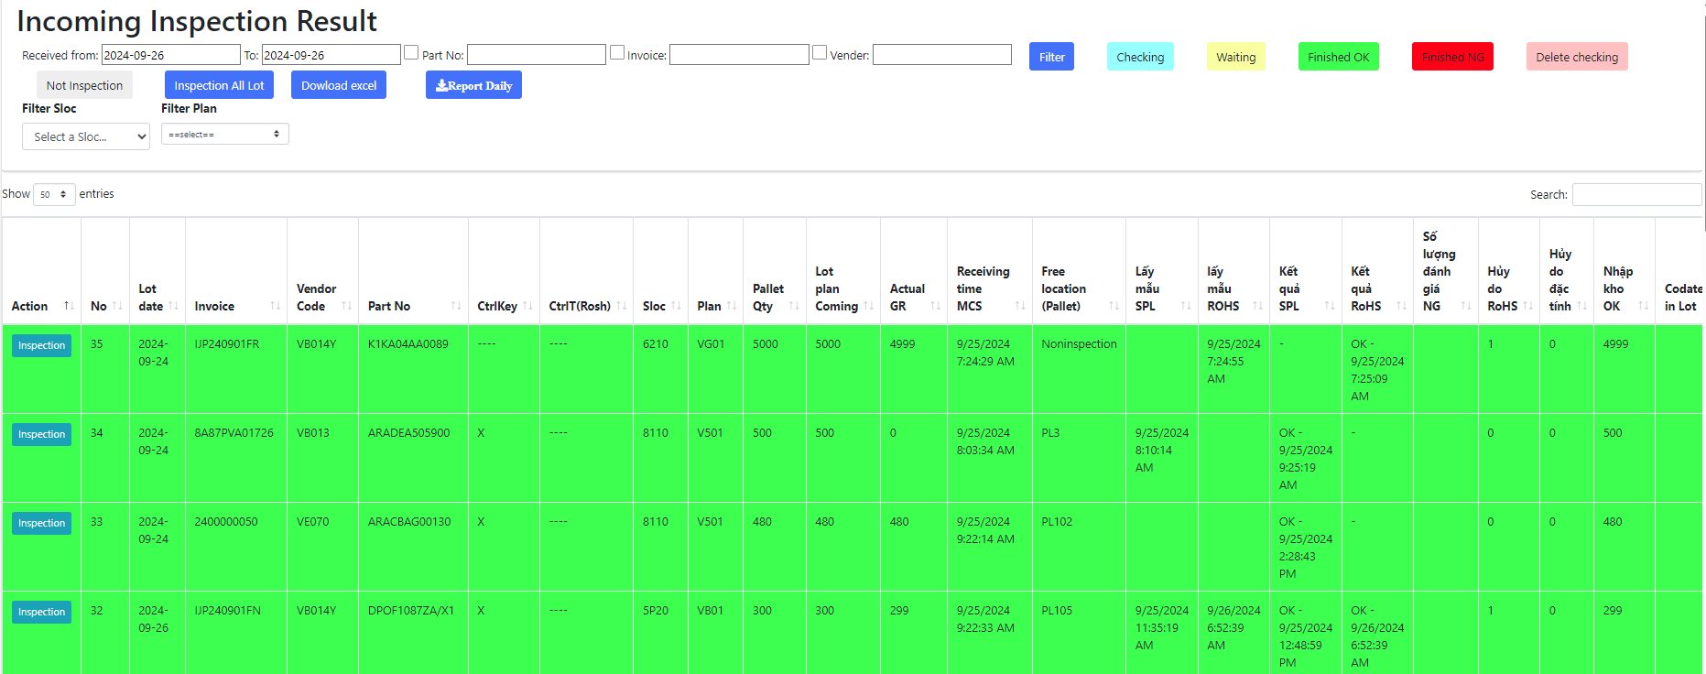

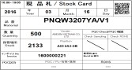
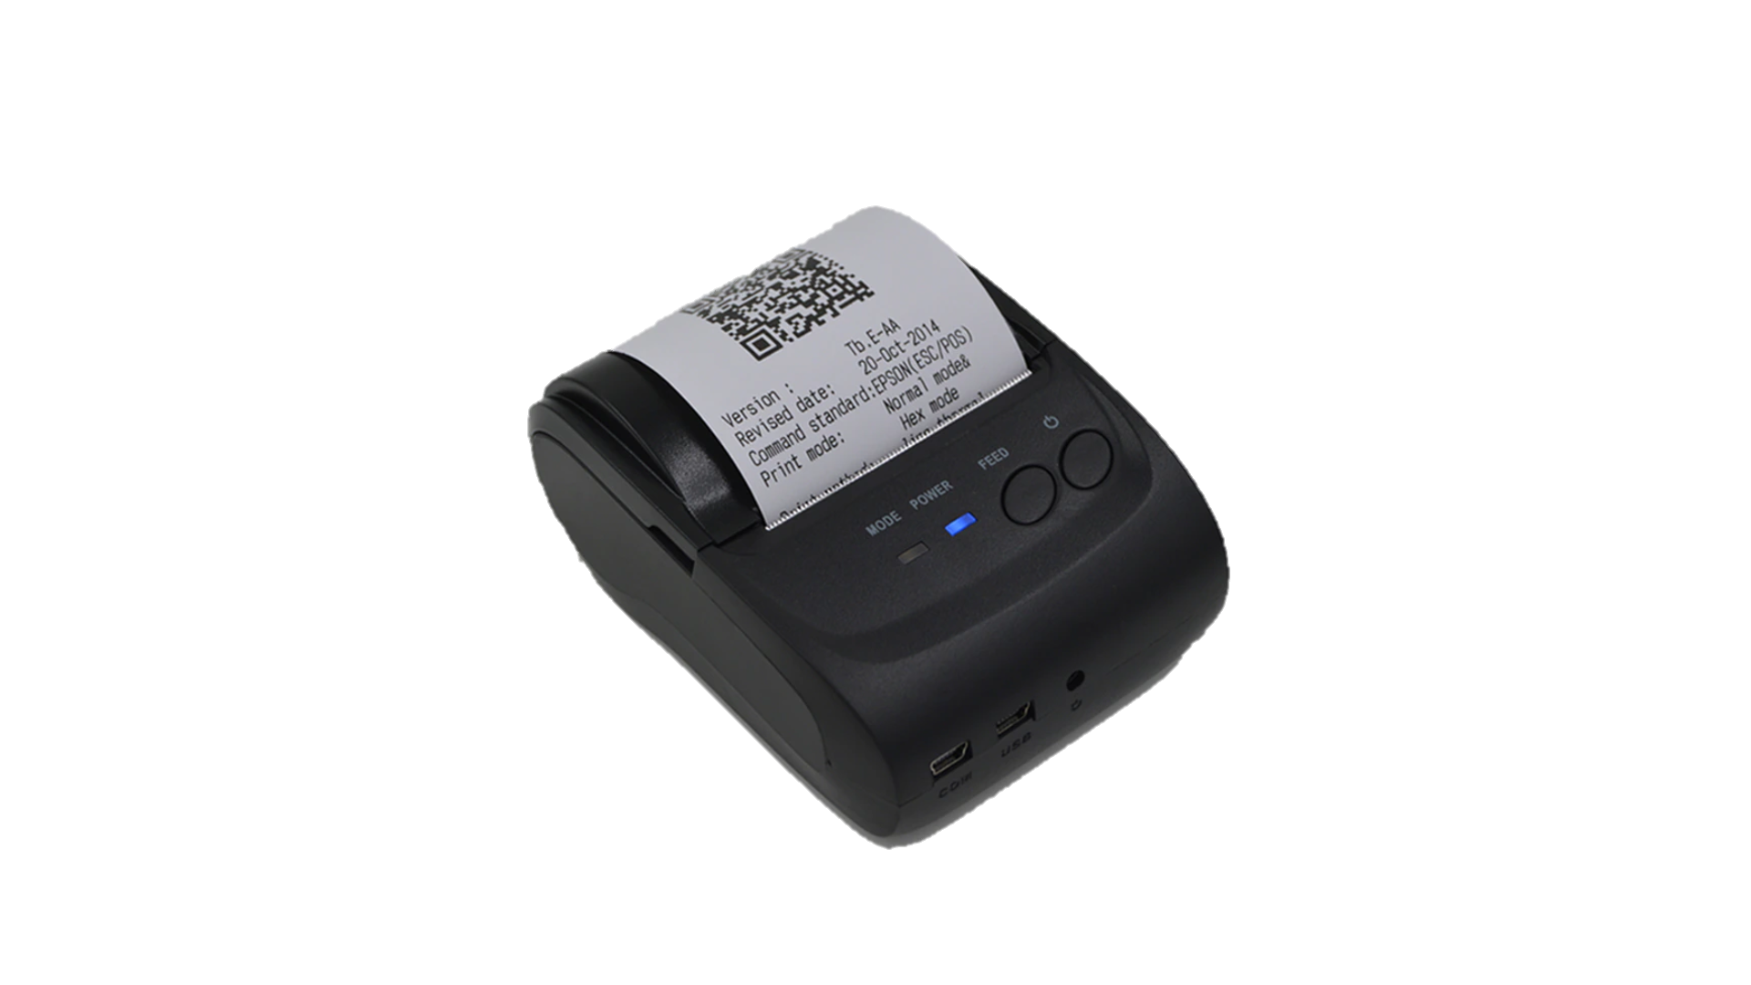
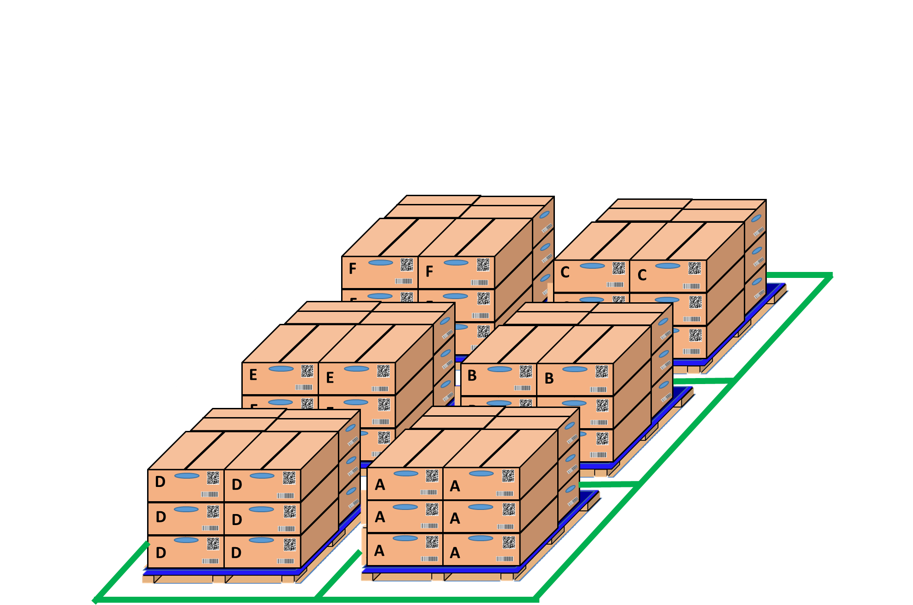



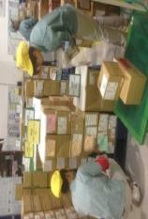

E chop for IQC inspection
Replace physical stamp by electronic stamp for IQC
Developer: Nguyen Nhu Minh
Apply: Aug 2024
Expense: 0
Reduce : 1Pax
◆ Before
◆ After
PROCEDURE
Visualize the IQC inspection
Inspection
OK
MCS
Good receipt
IQC check
Storing
Direct print stock card
PQC
Sampling
Loss time to chop stamp
Update
Inspection
Update
IQC pick up sample
Non-inspection
NG
OK
IQC pick up sample
NG
location
Inspection
SWMS
Inspection OK
NG
OK
IQC inspection
PQC
Sampling
OK
NG
NG
OK
OK
NG
Day- Month- Year
OK
PQC
Day- Month- Year
OK
PQC
IQC inspection
Loss time to physical stamp OK /NG
Day- Month- Year
IQC judgment OK/NG auto judgment All lot
PQC
IQC find location and chop stamp all lot
Make function inspection IQC on web and mobile replace chop stamps.
Merit: Reduce 1 Pax.
IQC lost time chop stamp when pick up the sample box.
IQC lost time find location and chop stamp all lot after inspection.
Improve :
Currently :

Slide 7
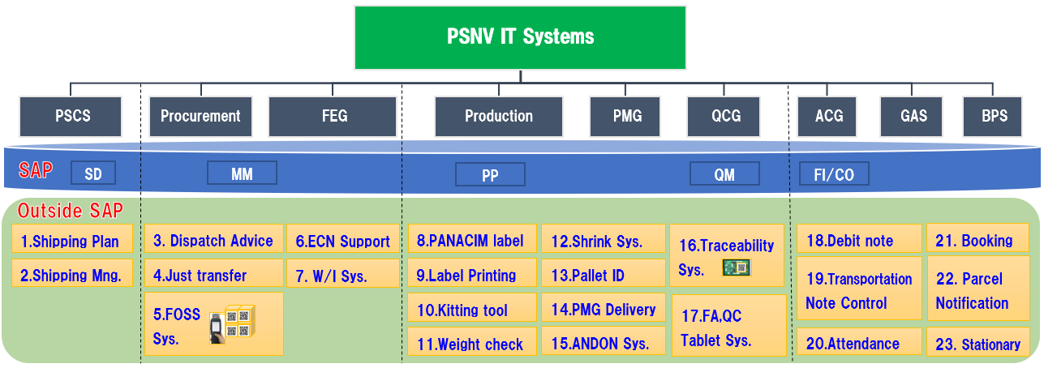
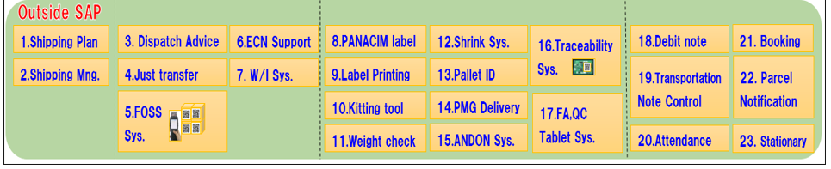
PSNV SYSTEMS OVERVIEW
SD: Sales and Distribution
QM: Quality Management
MM: Materials Management
FI/CO: Financial Accounting/Controlling
PP: Production Planning
Info: EDI, Sales order, Packing, Shipping instruction, Invoice
Info: Material Master, Engineering Change Notification (ECN), Purchase Requisition, EDI Purchase Order, Shipping Advise,
Dispatch Advice, Invoice
Info: BOM structure , Production Plan Monthly / daily, Transfer Posting, Backflush, Sub-Material
Info: Daily coming RoHS inspection,
Recording Inspection result, RoHS grouping, sharing
Info: Business Plan, Fix asset,
G/L Account posting
24. MCS Free
location

Slide 8

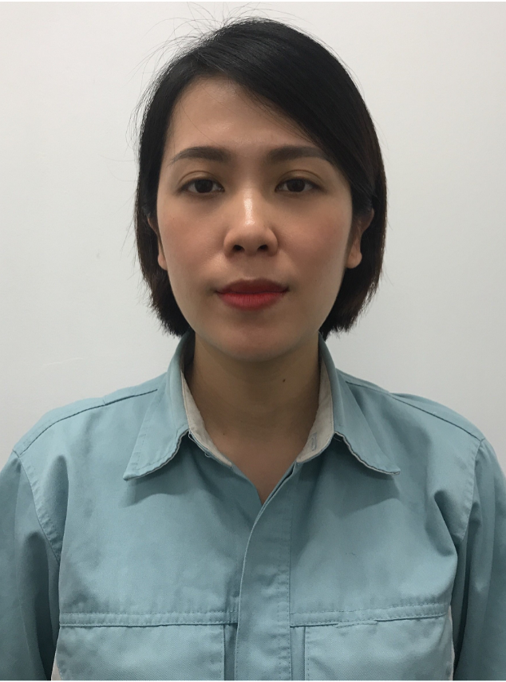



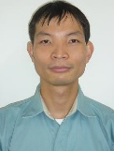
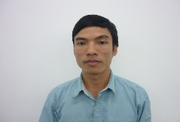
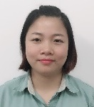
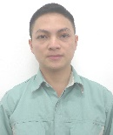
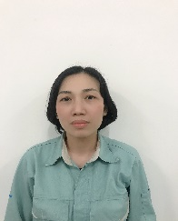
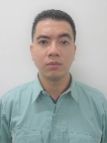
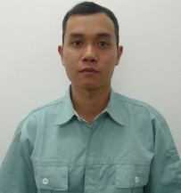

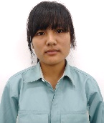
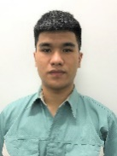
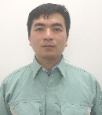
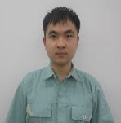
ISD Organization
GM
Date: 14th / Oct / 2024
Version: 11
Matsushita
SCM Solution
IT Planning
Manager
Manager
Management
SAP
SOX
Management
All Development
Budget Control
Nguyen Thi Thuy
Nguyen Van Chung
Infrastructure
ISM
System Development
Supervisor
Supervisor
S.Specialist
Supervisor
Supervisor
Specialist
SAP ABAP
SAP
IT Training
VBA Development
Infrastructure
ISM
Budget control
Development
Project management
Nghiem Hien
Lam
Le Thu Hoa
Do Minh Toan
Mai Ngoc Trinh
Tran Thi Huong
Nguyen Van Hien
Supervisor
Officer
IT Tool control
Japan system
support
Officer
Leader
S.L.Leader
Officer
Officer
Officer
Officer
Nguyen Thi Thanh Hoa
Nguyen Viet
Trung
Vu Duc Chinh
Pham Duc Viet
Le Thi Hai
Hoang Ngoc Lan
Truong Quoc
Phong
Nguyen Nhu Minh
Nguyen Tuan Anh
SAP ABAP
PC, LAN
PC, LAN
Budget control
Contract
& Payment
Development
Development
Development
Development

Slide 9
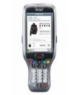
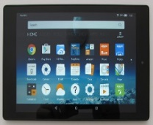

4. ACTION PLAN
8/10
59K$/Y
ACTION 2: EXPAND FOSS
Activity 2: Link FOSS with relevant systems Ensure Quality(03/2018)
HOW TO DO
TARGET & PLAN
Link FOSS to concerned systems for error (prevent quality issue)
FOSS & ANS
(08/2017)
FOSS & ECN,
Smart device
(12/2017)
HULFT to transfer data real-time
Line Indication
HT
Tablet
SAP
HULFT
ECN change
Part A -> B
Weight Check
ECN change
Part A -> B
Part No :
A
Part No :
A
ECN change
Part A -> B
A
Part card:
A
Part card:
A
Part No :
QTY:
30
QTY:
30
Part No :
A
Please check carefully
Part card:
A
QTY:
30
Part card:
A
Date
Plant
Cat
ECN
Please check carefully
FOSS
Visualization
QTY:
30
40K$/Y
Weight
Please check
2. Link FOSS to all existed system - Everything connects
Production
Visualization
(03/2018)
Procurement
SMT
FOSS
FA
PSCS
Dispatch Advice (DA)
Barcode
Scheduler
MCS
Weight
Check
Packing
Check
SMT
Management
PT200
DIP
Shrink
System
Shipping
Control
E-PRO
PANACIM
PMG
Notes:
(1.5m)
Next is activity 2 for expanding FOSS
First FOSS will link to relevant systems to notify error: we link SAP,HULFT, FOSS,ECN and Weight check
To visualization on any device (example: Indication ECN change on Pro.Line PC, HT, Tablet)
Second FOSS will link to all existed system, everything connects to enhance management.
OK We’ve looked at ACTION PLAN.
Now we’ll move on to DEVELOPMENT PLAN

Slide 10
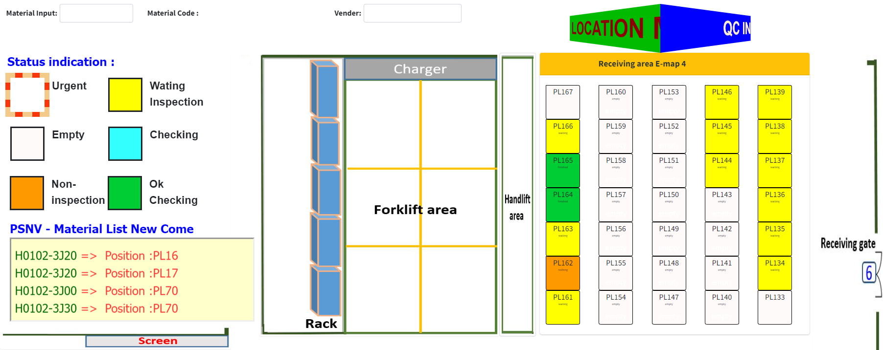
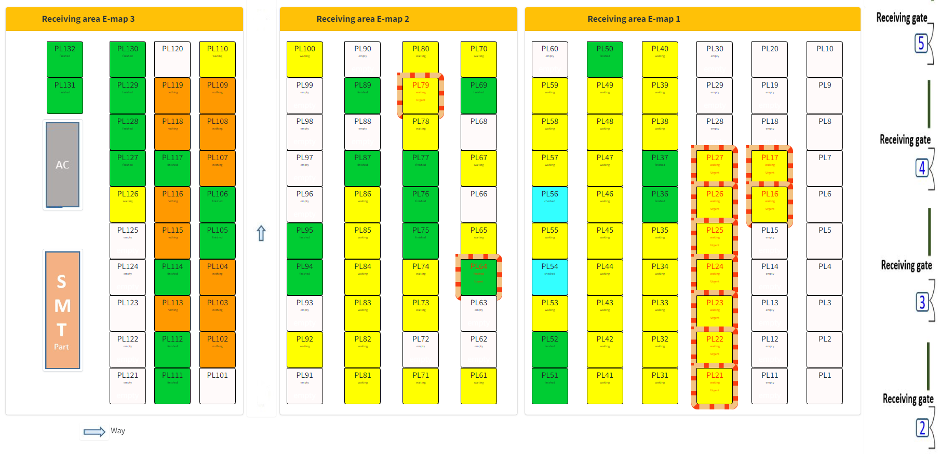
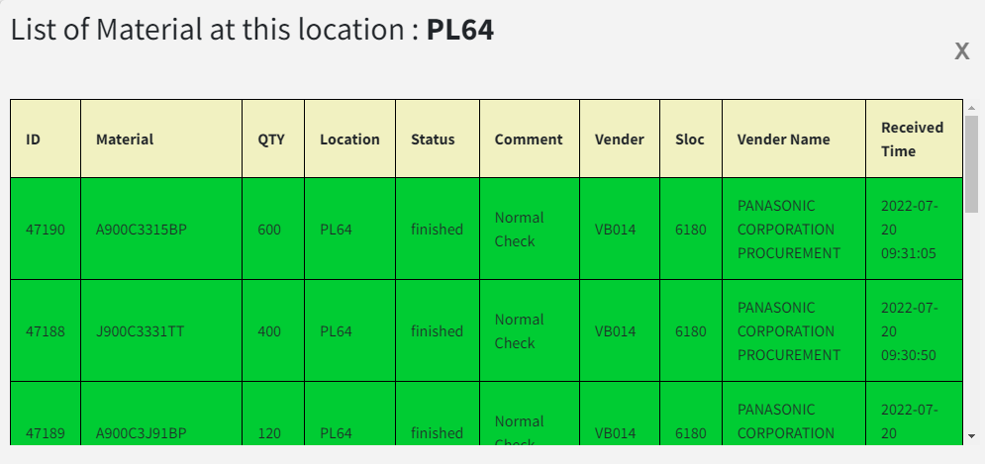
MCS – QC FREE LOCATION
Main Function
Real location indication
Inspection status
Urgent Pallet & Material notice
New material location coming

Slide 11
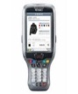
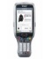
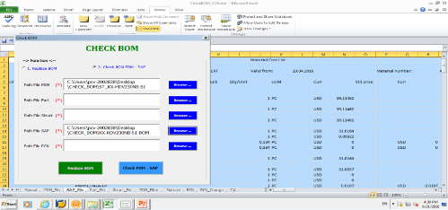



FY2019 DEVELOP SYSTEMS
289.4KUSD
11/17
1
ROH – HALB – FERT FACTORY STREAMLINE TIGHTEN CONTROL
・MCS
・PQC
・SMT
・DIP
・PMG
・FA
・OQC
・PSCS
SAP
A2
A1
Sys
B2
B1
ECN change
Part A -> B
Part No :
A
Part card:
A
DB
DB
SAP
DB
QTY:
30
C2
C1
Date
Plant
Cat
Please check carefully
Free location master control
Insp./urgent Part,
in order & Map.
Check Part by character scan
Scan part card in DIP Process
Improve PMG delivery process
Control Sub & SP Mat.
Multi Job by Tablet
E-Tally Control
2
REDUCE INDIRECT MANUAL JOB
・FE
・PMS
・ACS
・GAS
・BPS
Master
BOM
Post Diff. by group (instead of PI)
Prod.
Line
Mng.
PDM
IP
PAPVN
DB
DB
Control PAPVN BOM by System
Control Monthly Post Diff. by S.loc
HR System Data Utilization
Stationary Control System
3
RESEARCHING TECHNOLOGY - TOWARDS SMART FACTORY 2019 -2024
Notes:
The 1st is ROH – HALB – FERT FACTORY STREAMLINE TIGHTEN CONTROL.
Free location master control in MCS, base on that PQC can show a map on smart device to check sampling or urgent part.
In the SMT, we will check part more strictly by character scan.
In DIP process also use barcode part card to scan.
Then we have plan to improve PMG delivery process by input SAP directly.
control Sub & SP Material in FA
Multi Job on Tablet for OQC & E-Tally control for PSCS
Beside we will reduce Indirect Manual Job By Control PAPVN BOM for FE and PMS.
Control Monthly Post Diff by S.loc for ACS, Prod. Line Management base on HR System Data
Stationary control system for BPS.
researching technology – Towards smart factory
Such as: SAP Hana,Log Analytics, Pattern Recognition, Machine Learning and Deep Learning.
Next one, I want to say briefly about action plan schedule.
As you can see here is the plan for Production, PSCS,Procurement,etc .. And ISG.
Finally shall we keep work safe for your life and family together.

Slide 12




OQC Quality Report
PEAC
A. FY2024 PEAC Market Claim – Summary Apr~Oct.24
Sound Biz
Sound Biz
Pending point :
PEAC Market claim Target Zero but until Oct’ become increase ➔ Total 3 cases all concerned Sound Biz
2 cases concerned risky in assembly in the process
1 case concerned part problem from maker
➔ This is serious situation, concern sections quickly take corrective action to stop Market claim
3
MIC cannot Charge
Adaptor NG
2
Connector NG by Bond
1
0
0
0
Details Market Topic Issue in Oct.24
Problem | Main cause | Action & Countermeasure
Problem : Product cannot power on (1st time using at customer ) Model: WX-SZ200 NG serial : WK0004 & XB0064 PSNV History : Production date: Nov-23 & Feb-24 4M change/Rework/Repair : No | Root Cause: AC adaptor ( PGLV1018XA/J1 (ATL Technology ) Pass cause: Process have 4 step need power on to check function but still have risk pass defect to market All steps do by 1 member & confirm by manual Have risk mixing adaptor before & after function check (prepare other adaptor on same table while current set not yet finish) | Action: Confirm FG of concern models using this AC adaptor : stock is zero. Confirm single part in stock: 125 pcs → Checked by X-ray → all OK Counter-measure For Main Cause ( Marker ): Under confirm with marker <Target: 17-Nov-24> Counter-measure For Pass Cause (PSNV) Re-arrange function steps to prevent operator mistake: ➔ Separate process for 2 operators to check verify function of product <Applied: 28-Oct-24> Make software for auto check power on & charging step & verify by logfile <Target: Apr-2025>
Problem: Product sometimes cannot power on. Model : WX-CH457 NG serial : XA0178/ XB0074/ 099/ 152/ 157 (FG) & other 15 pcs (SP) <ISBD>: | ISBD Suspect cause: Bond drip inside connector Pin → No good contact PSNV under investigate : Cannot re-produce NG situation (Not clear Main cause) ISBD/PSNV continue analysis this issue. Pass cause: Process have item check → Can detect if stable NG No power < History: No happen “ No power” issue concern CN201 and CN2 no good contact > | Action for FG stock: Confirm FG of concern models : Stock is zero Action for ISBD suspect cause: New production apply new lot bond loctite 410 (Dry faster than current lot bond) Change method attach bond to CN201 & method keeping PCB before assembly: + Before: Insert bond from Top side → Back side → Keep dry + After : Insert bond from Back side → Top side → Keep dry
Market-Sound

Slide 13





OQC Quality Report
B. FY2024 OQC Issue – Summary Apr~Oct.24
Pending point :
PEAC OQC issue not achieve target and still happen every month special for DP
1 case concerned part problem from maker
1 case concerned risky in our process
➔ Actual defect unstable and not worst trend but concern sections need to review process to eliminate the risk
Details OQC Issue in Oct.24
Problem | Main cause | Improvement Action
Problem: Abnormal image on monitor Model : VL-SE30XLA Pro date : 08-Oct-24 (84 pcs) NG Q’ty : 1/3 pcs | Main Cause: FE analysis NG by LCD part P/No: L5EDDYY00656 <Maker: Giant-Plus> D/C: 240806 (06.Aug.24) History part coming & using: D/C : 240805; 240806; 240816 Start using : 01.Oct.2024 Total use : 25,661pcs Inventory : 12,395pcs Pass Cause : This model running on automation line so cannot find out | Temporary Action: FA: FG aging 2.5mins after check display. Result: 74pcs all OK IQC sorting single part 200pcs. Result: OK All IQC already sent NG sample to maker for analysis (Waiting for Maker feedback report until 17.Nov)
Problem: Image of Monitor abnormal Model : VL-SE31XL (Automation line) Pro date : 10-Oct-24 (162pcs) NG Q’ty : 1/5 pcs (4JACA008765) | Root cause: Solder ball stick inside cable ➔ Make LCD pattern short Suspect cause: Due to connector near soldering MIC position ➔ Solder ball fly to connector position Pass cause: Due to LCD’s Pattern not yet short, so product still OK at FCT & FA (Recheck NG product on Automation line NG) ➔ There are 3 process of FCT & FA can detect (By FCT checker, Manual LCD/Keys/LED check & Automation - F2) | Action: Make cover on JIG to prevent solder ball drop to connector when soldering MIC ➔ Already improved for all 13 JIGs for 9 Lines
OQC-DP
LCD Abnormal Image
Solder ball
Image not clear

Slide 14
Oct.FY24 Main Activity Review
Oct.FY24 Target | Main KPI Activities | Status | Horizontal | P.I.C | Oct.FY24 Result
Out of process (case) e-Quality Market Claim OQC lot out | ⓵ DP Auto inspection Camera Manual =>Acoustic | Completed oct.24 | All Category | Production | Out of process (case) e-Quality Market Claim OQC lot out
 | ⓶ Create Part card of prepare process Manual =>Auto | Completed Oct.24 | DP : 2Lines | Production
 | ③ Add Traceability & Verification of Manual Book | Completed Oct.24 | DP : 7Lines | Production
 | ④ Change design hole of Stencil to reduce solder bridge | Completed Oct.24 | DP Preparation | Production IT PE
In of process (Ratio) DP DECT TV SB | ⓵ Confirmation of 4M change checklist through direct audits and online meeting with maker. | On schedule | 24/50 Makers | QCG PUR | In of process (Ratio) DP DECT TV SB
 | ⓶ IQC/PUR Strengthening direct audits of overseas manufacturers. | Done | 4/4 Makers | QCG PUR
 | ③ Evaluation of Maker process risk using QC process control chart | On schedule | 3/5 Makers | QCG
: 0
: 0
: 1
: 0 [X]
: 0 [X]
: 2 [X]
: 0.134%
: 0.124%
: 0.228%
: 0.063%
: 0.133% [O]
: 0.122% [O]
: 0.215% [O]
: 0.048% [O]

Slide 15














Oct.FY24 Improvement Action in Detail
DP Camera Auto Inspection
Add
Prepare - Auto print Part Card
Expected Effect
Continuous
MAIN LINE
Quality improve
Harenchi error
Method error
Human error
:0
:0
:0
Alo 1,2…15
DP Auto CMR inspection
No sound : 0
Small sound : 0
OP 2
Application : DP
Application : All Category
Auto print Part card
Wrong model : 0
Wrong part : 0
Auto tall check & detect sound error
Preventive Human error
Preventive wrong part by human mistake
Reduce manual loss time
Done [Oct.24]
Done [Oct.24]
Traceability OP book
Wrong part : 0
Missing part : 0
Add
Traceability OP. books & S/N
Add
SMT – Change design stencil
Assembly
Inspection
Pair S/N
Scan Manual book
Weight check
Change design stencil
PCB Pass defect : △30%
Link
Link
Improve solder condition by change design hole of stencil
Headcount improve
Direct : △ 02pax
P/L : △ 12K USD
Excel tools . No link
Traceability & Verify
Solder bridge
Application : DP.MW.DECT
Application : All Category
Indirect job reduce
Manual job: ∆450h/Year
Traceability of Manual book . Serial No
Reduction of loss time
Reduce Open . Solder bridge defect
Prevent pass to next process
Done [Oct.24]
Done [Oct.24]

Slide 16









DECT-PHONE Inline topic
Problem | Main Cause | Action | Status
Model : TG68 .TGD310 . TGD312 Problem : LCD FFC peel of after heat sealing.(LCD unstable display) NG Q’ty : 9 / 1,447pcs NG ratio : 0.6% | Under investigate : Analysis based on 4M conditions : MAN : Confirm operation METHOD : Confirm daily check MACHINE : Confirm machine condition and have some NG points MATERIAL : Confirm LCD conditions | Temporary actions : Recheck F/G from 1-14/Oct (NG 2/300pcs) Increase temp welding 152oC -> 162oC Operator 100% visual check after welding Long term actions : Change Horn temperature and Air Pressure Revise daily check sheet to increase frequency of checking horn temp (3-> 4 times). And additional of step check balance at heat seal. Add sound warning function when sudden air pressure loss Follow up results | Pending
Handset line
Assembly
Test Mode
NG : 8pcs
FCT
Base line
Assembly
ID
Still NG
Bell check
NG : 1pcs

Slide 17

Bao cao thang 9 hoa

Slide 19
Total Market Quality Summary
G:\QC\04 GQC\3. QUALITY REPORT\4.(C_) Monthly Quality Report\(C_)_FY2024\8.(C_)_Nov
FY2024 Market Claim
Market claim (Apr~Nov.24)
Breakdown by 4M
Pending point
Market issue not reduce trend so not achieve target
Caused by Man high ratio (Almost at PAPVN)
➔ Concerned sections need to take more strong improvement action to prevent defect leak to Market
7
6
4
4
2
5
4
7
Details 4M analysis (Apr~Nov.24) : 39 issues
4M | Ratio | Improvement action | Pending point | In-charge
Man | 11 issues (28%) | Built up verify system to prevent skip process (Excel logfile) Setup VC to prevent PCB defect | Continue verify system for Web logfile FCT | PE/R&D
Method | 8 issues (20%) | All operators in charge of insertion connector process must be trained and certified | Continue monitoring & follow up | FA/FE
Part | 6 issues (15%) | Arranged meeting with Maker to make clearly improvement action | Maker long time feedback (Overseas Makers) | IQC
Machine | 5 issues (13%) | Improved welding matter | Continue follow up | PMD/PE
Others | 9 issues (24%) | Already have improvement action for individual defects | Continue review risk point on process | All sections

Slide 20





OQC Quality Summary
B. FY2024 OQC Issue – Summary Apr~Nov.24
17
Pending point :
PEAC OQC issue continue happen every month special for DP
DP : 2 cases concerned part problem from maker
TV : 1 case concerned SMT process
IQC need strongly claim maker to take countermeasure
Process continue review & improve machine to detect defect in line
15
Not achieve Target
7
8
0
2
0
3
Details OQC Issue in Nov.24
Problem | Main cause | Improvement Action
Problem : Happen Low button Model : VL-SE31KL Pro’s date : 5-Nov-24 Lot size : 478pcs NG q’ty : 1/4pcs ~25% | Main cause: Terminal part NG (Lack of spring inside) Part No: K4AC02B00061 (Date Code : Not clear) Maker : SHANGHAI HUAHONG HONGRI ELECTRONICS (SHENZHEN SUCCEED) | Recheck FG stock at PSNV (belong 3 lots incoming) Total Q’ty: 73K pcs .D/C: 6 D/C → IQC sample checking: 0/6K pcs → All OK Cause from Maker: Due to NG part was not inspected after repair. Control repaired parts not good so mixed with normal products Maker countermeasure: Make caution point and training for operator before operation Update material flow card, maintenance products separate identification, separate flow Defective products confirmed verification result by production, QC, Engineering Change AQL from AQL0.65 → AQL0.4 for 3 lots
Problem: Missing character on inner carton Model : VL-V571L-S Pro date : 13-Nov-24 Lot size : 168 pcs NG Q’ty : 1/5 pcs | Main Cause: INNER CARTON part NG <P/No: PNPK3396001YA/V1> (Maker OJITEX BN) Belt used long time → Connection point of Belt peel off → Press & made concave on paper sheet → When printing happen lack of ink Pass Cause: Maker found out NG & checked 100%, but checking method not good → Remain NG parts pass to PSNV | Temporary Action: Re-check F/G. Result: NG 2/163 pcs → Total NG 3/168 pcs ( 3pcs NG same Up number 2 ) IQC sorting single part. Result: NG 0/12 pcs Countermeasure: Repair peel off point of belt (Applied: 9-Nov-24) Add check belt point into daily check sheet. Change checking method & add into checking rule. Training for all members about defect & countermeasure.
Problem : HDMI port2 NG Model : KV-55Z85AEG Lot q’ty : 178 pcs NG sample : 1/3pcs | Main Cause: Foreign material attach under resister R4635 <the foreign material drop on PCB before printing solder> Pass Cause: VC3D not detect this problem→ Pass defect. FCT not detect this problem (log file of NG PCB is OK). FA no have item check | Temporary Action: Recheck all WIP PCB stock by microscope same position => Result : NG 0/368pcs Re-check F/G 2 pcs serial number before & after NG set => Result : OK all Countermeasure: Request PED add step check at FCT checker <Under study> Long time contact with VC3D support detect this problem <Completed : E of Nov>
DP
Part NG
Low button
Part NG
DP
TV
Machine
NG
No display when input signal to HDMI2 port

